Slide 1

Somatic Experiencing:
A Randomized Controlled Outcome Study.
Danny Brom
Cathy Lawi
Gina Ross

Slide 2
Team members
Gratefully acknowledged
Karen Lerner
Yaffa Stokar
Vered Nuriel-Porat
Ricky Bernstein
Arye Frank
Nadia Hofman
Adar Lavie
Dvora Rosner-Wax
Salomka Donievsky
Yuval Ziv

Slide 3
Randomized controlled study
Basis:
No previous randomized controlled study was conducted on Somatic Experiencing.
SE has become increasingly popular
3. Clinical reports are very positive and show that “exposure to traumatic stimuli” might not be necessary or can be done in regulated ways.

Slide 4
SE protocol 15 session by Gina Ross
Structure used for each session:
• Purpose: The topic/goals of the session
• Review: To update the therapist about events/thoughts during the past week
• Psycho-educational targets: The concepts to be taught to the client during the session
• Therapeutic activities: SE exercises or activities to be used during the session to fulfill the purpose of the session
• Homework: Activities the client is to complete between sessions

Slide 5
Example of a session (session 3)
Purpose:
• To introduce titration and pendulation
• To use “story” to trigger activation
Review:
• Review of symptoms
• Review of ability to ground self
• Review of ability to tune into the Felt Sense
Review ability to use resources during the week

Slide 6
Psycho-educational targets (session 3)
• The use of “story” and the potential danger associated with the linear story
• Pendulation (Figure 8 diagram, train analogy, polarity)
• Titration (chemistry analogy)
• Discharge: normalize signs and process (giving it time and attention, elaborating on places from where energy to be discharged comes out)

Slide 7
Therapeutic activities (session 3)
• Working with the story content of a traumatic event: managing activation around story by working first with the beginning or end of the story
• Titration and organic pendulation
• Purposeful pendulation (pendulating between a resource and the activation)
• Using antidotes or opposites to discharge (ask for the image of the stuck sensation and take it to the body to create movement out of the stuckness)

Slide 8
Homework (session 3)
• Tracking moments of activation during the week, using resources, and discharging activation

Slide 9
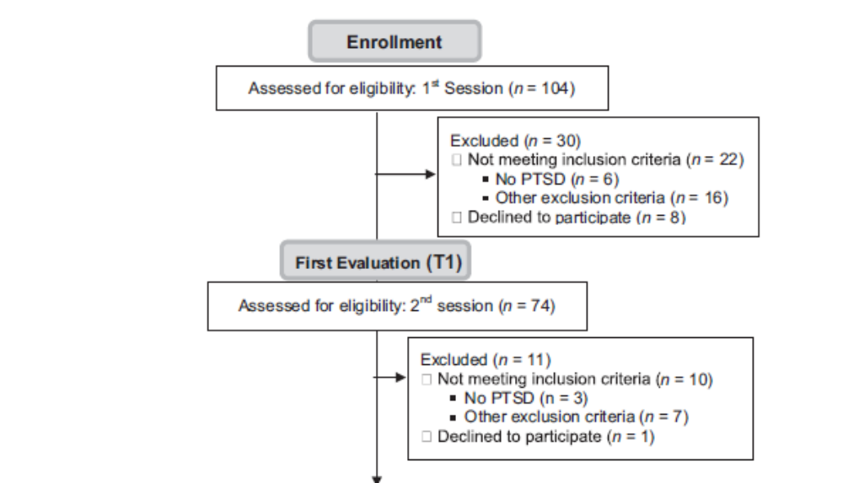
Sample

Slide 10
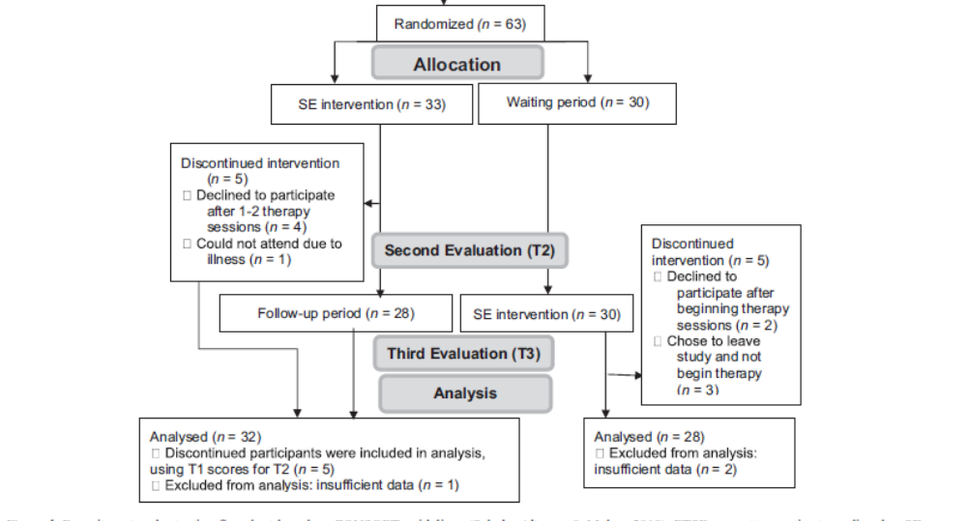
Sample

Slide 11
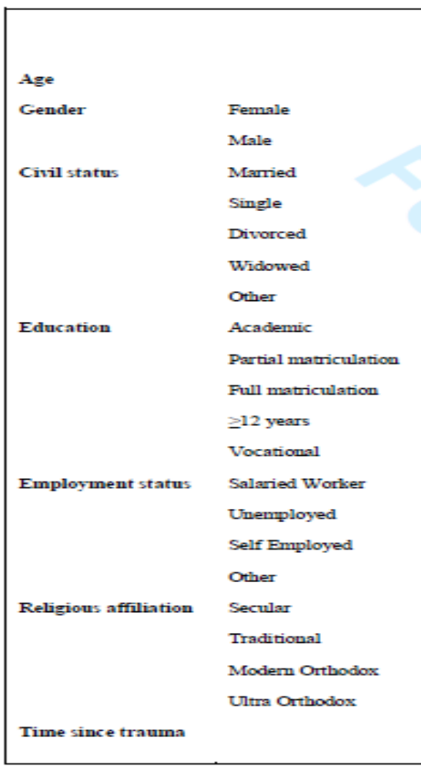
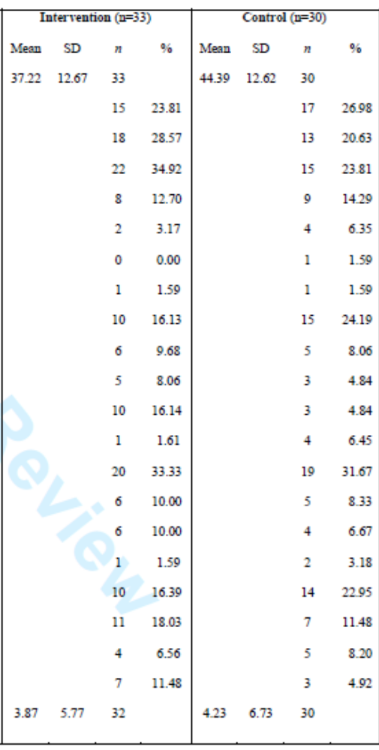

Slide 12
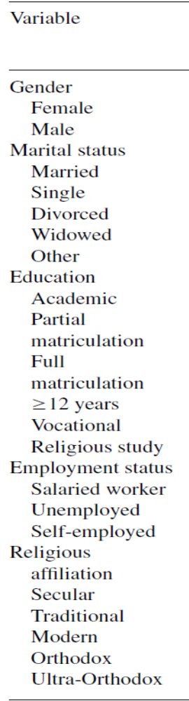
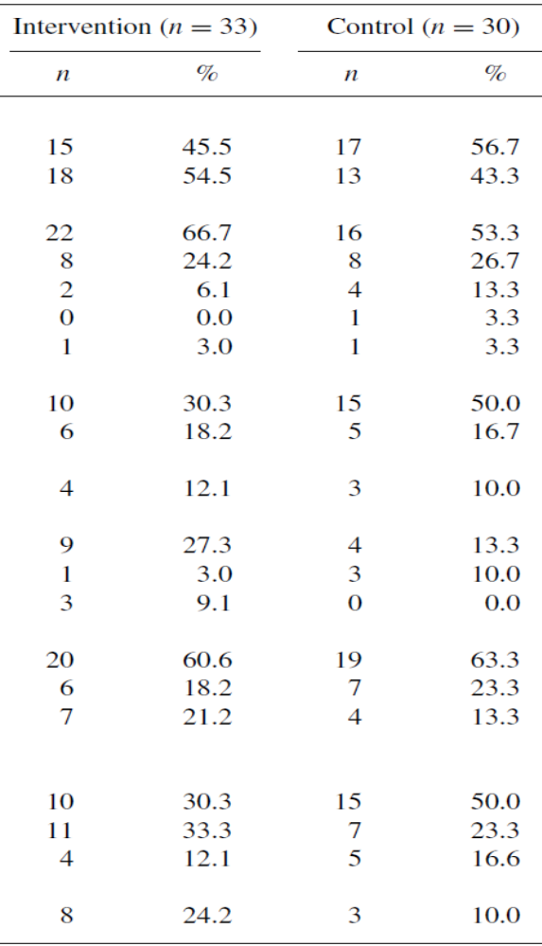
Demographics
No Significant differences

Slide 13
What did the participants go through?
vehicle accidents 27 (43%)
assault cases 7 (11%)
“other” types of accidents 6 (10%)
death or injury of a family member 5 (8%)
terrorist attacks 5 (8%)
medical trauma 4 (6%)
shooting cases 3 (5%)
exposures to deaths of others 2 (3%)
“other” traumas 4 (6%)

Slide 14
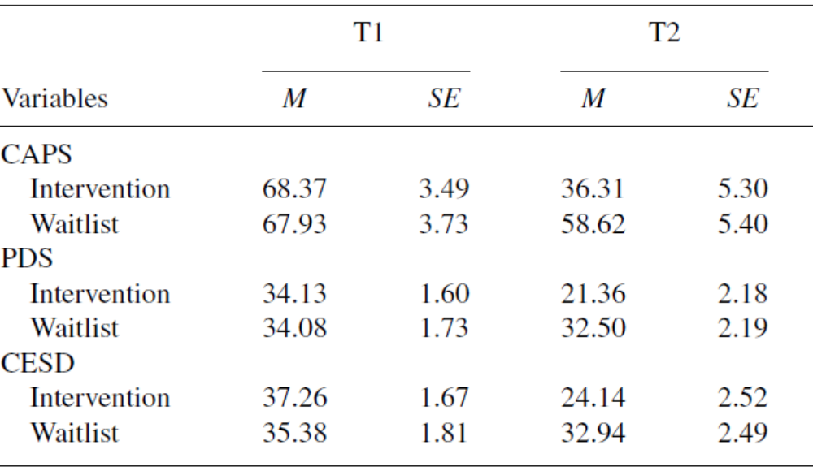
Results of SE vs Waiting List

Slide 15
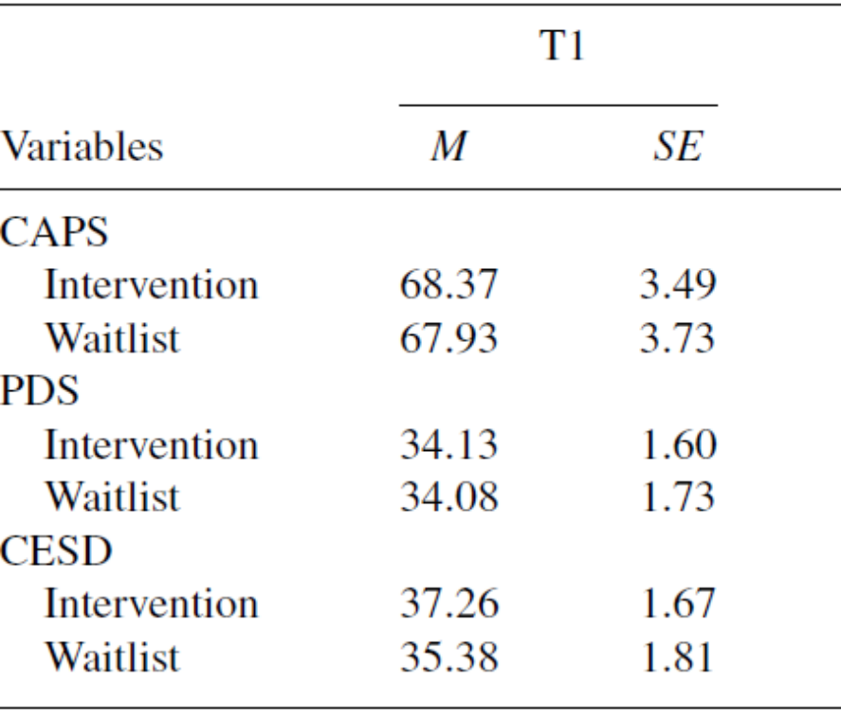
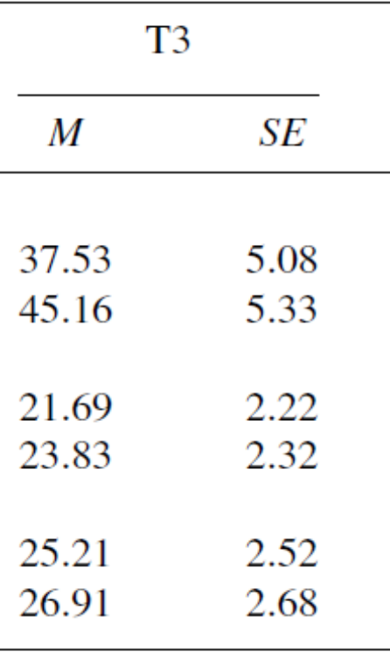
Results of SE

Slide 16
Severity of Posttraumatic Symptoms Measured by CAPS (Means)

Slide 17
Severity of Posttraumatic Symptoms Measured by PDS (Means)

Slide 18
Severity of Depression Symptoms Measured by CESD (Means)

Slide 19
Results per diagnosis
70% of participants had a significant reduction in symptoms
44% of the people lost their diagnosis of PTSD

Slide 20
Conclusion
SE was shown to be an effective treatment mode
Some clients remained in a chronic state
More work needs to be done on specific populations, such as combat PTSD
Limitation of the study:
  Environment of ongoing attacks
  Naturalistic study

Slide 21
Future plans

